Slide 1
U-NET, SEGNET, MASK-RCNN

Slide 2
Image segmentation
Process of dividing an image into meaningful regions by assigning a class label to each pixel.
Unlike image classification, which labels the whole image, segmentation provides detailed understanding at the pixel level.
Example:
Classification → “Tumor Present”
Object Detection → Rectangle around tumor
Segmentation → Exact shape and boundary of tumor

Slide 3
What is U-Net?
U-Net is a deep learning architecture mainly used for semantic image segmentation.
It classifies every pixel in an image into a specific category, allowing precise identification of objects and boundaries.
It was originally developed for biomedical image segmentation but is now used in many computer vision fields.

Slide 4
Why is U-Net Important?
U-Net is important because it provides very accurate object boundaries.
In medical imaging, even a small mistake in identifying a tumor or organ can affect diagnosis and treatment.
U-Net solves this problem by preserving fine image details.

Slide 5
Why is it Called U-Net?
The name U-Net comes from its U-shaped architecture. It consists of two major sections:
Contracting Path (Encoder)
Expanding Path (Decoder)
Between them lies a bottleneck layer.

Slide 6
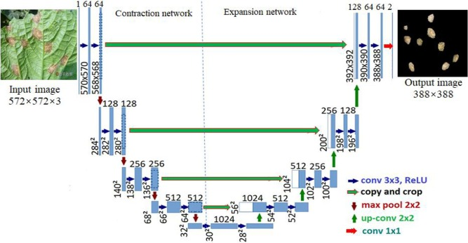

Slide 7
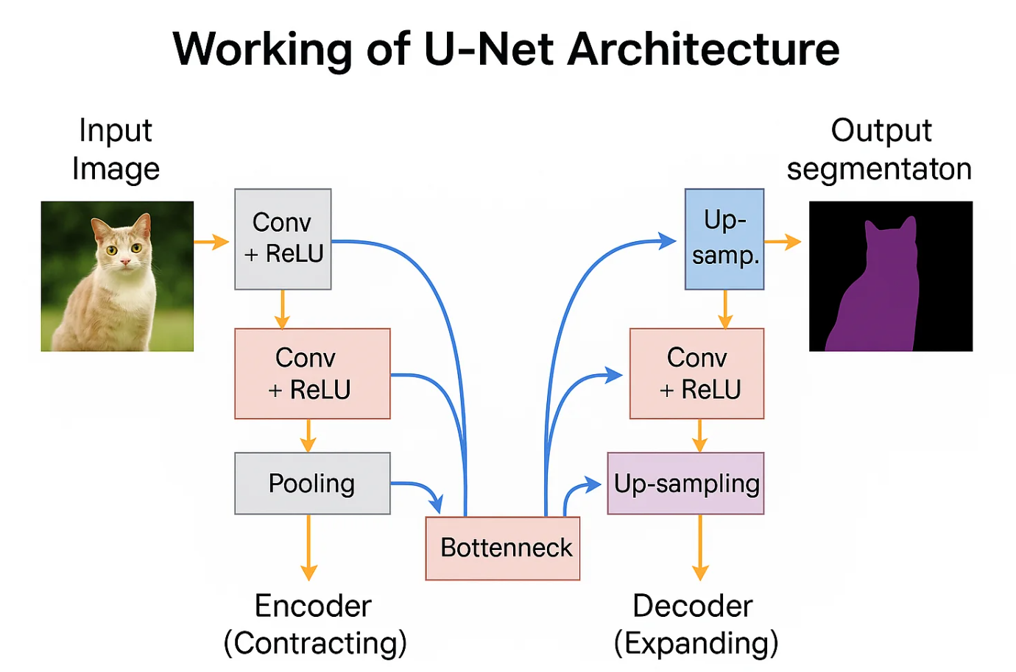

Slide 8
Main Components of U-Net
Encoder (Downsampling Path)
Bottleneck Layer
Decoder (Upsampling Path)
Skip Connections
Together, these components help extract features and reconstruct precise segmented images.

Slide 9
Contracting Path (Encoder)
The encoder is responsible for extracting features from the input image.
It applies convolution layers, activation functions, and pooling repeatedly to understand patterns in the image.
The image size becomes smaller while learned features become richer.

Slide 10
Convolution Operation
Convolution applies filters to identify patterns such as:
Edges
Corners
Textures
Shapes
Early layers detect simple patterns, while deeper layers identify complex structures like organs or roads.

Slide 11
Activation Function (ReLU)
After convolution, U-Net commonly uses the ReLU activation function.
Purpose of ReLU:
Introduces non-linearity
Helps learn complex relationships
Improves training performance

Slide 12
Pooling Layer
Pooling reduces image dimensions while keeping important information.
Example: 256 × 256 → 128 × 128
Benefits:
Reduces computation
Removes unnecessary details
Focuses on important features

Slide 13
Feature Learning in Encoder
As depth increases:
Initial layers → detect edges and textures
Middle layers → identify shapes
Deep layers → understand complete objects
This hierarchical learning helps the model understand images effectively.

Slide 14
Bottleneck Layer
The bottleneck is the center of U-Net where the image representation becomes highly compressed.
At this stage:
Resolution is smallest
Features are highly informative
Semantic understanding becomes strongest

Slide 15
Expanding Path (Decoder)
The decoder reconstructs the image to its original size.
Its goal is to create an accurate segmentation map by gradually increasing image resolution.
Example: 64 × 64 → 128 × 128 → 256 × 256

Slide 16
Upsampling in U-Net
Upsampling increases image dimensions and restores lost information.
However, enlargement alone is insufficient because fine details may disappear during pooling.
This issue is solved using skip connections.

Slide 17
Skip Connections
Skip connections transfer feature information directly from encoder layers to decoder layers.
Their purpose is to preserve:
Fine boundaries
Object location
Small details
This is one of the most important innovations of U-Net.

Slide 18
Importance of Skip Connections
Without Skip Connections:
Blurry boundaries
Small objects disappear
Poor segmentation
With Skip Connections:
Sharp boundaries
Better localization
Higher accuracy

Slide 19
Working Process of U-Net
Input image enters encoder
Features are extracted
Pooling reduces dimensions
Bottleneck learns high-level information
Decoder upsamples image
Skip connections restore details
Final segmented mask is generated

Slide 20
Loss Functions in U-Net
Loss functions measure prediction error.
Commonly Used Loss Functions:
Cross-Entropy Loss
Dice Loss
Dice Loss is especially useful in medical image segmentation because it measures overlap accuracy.

Slide 21
Dice Coefficient Formula
Dice Coefficient:
Dice = 2(A ∩ B) / (A + B)
Where:
A = Predicted region
B = Actual region
Higher Dice Score = Better segmentation accuracy.

Slide 22
Advantages of U-Net
U-Net offers several benefits:
High segmentation accuracy
Works with small datasets
Excellent boundary detection
Strong localization performance
Widely used in medical imaging

